Slide 1
The Interaction Effect Between Modality Interactivity and Smokers’ Quitting Intentions
Meredyth Binder, Diego Ramirez Meda, Sarah Nahas

Slide 2

Research Question
Can Liking, Commenting, and Sharing Enhance Persuasion?
Notes:
Diego
The Interaction Effect between Modality Interactivity and Agency Affordances on Smokers’ Quitting Intentions

Slide 3

Literature Review
Modality Interactivity
  Features that provide users with various ways of accessing information
  E.g. Sliders, Zoom-in, Mouseovers
Systematic Processing
  Message processing where individuals form their attitudes by examining their thoughts, prior beliefs, and knowledge about the topic and integrate the information to reach a judgment, assessing the existing associations and experiences available in their memory
Telepresence
  The feeling of being immersed in a mediated environment
  Hypothesized to be enhanced by Modality Interactivity
Agency Affordances
  Sense of Agency + Affordances
  Social Media Plugins
Notes:
Diego
M.I. - found to enhance feeling of flow, create more positive content perception, and increase telepresence
Systematic Processing - taking in info online, applying prior knowledge and coming to your own conclusions
Agency affordances - sense of agency = sense of self. the feeling that we initiate and control our own actions. We create the image we want to present.
Agency affordances - opportunity online to express ourselves and obtain a goal. Theory of Interactive Media essentially explaining that having interactive features on a website helps us create a sense of identity when online.

Slide 4
Hypotheses
Agency affordances such as social media plugins will enhance feelings of telepresence on the website (H4a) and systematic processing of health messages (H4b) by boosting sense of agency
Agency affordances will enhance the positive impact of modality interactivity on telepresence (H5a) and reduce the negative impact of modality interactivity on systematic processing (H5b)
4. Agency affordances such as social media plugins will enhance feelings of telepresence on the website (H4a) and systematic processing of health messages (H4b) by boosting sense of agency
5. Agency affordances will enhance the positive impact of modality interactivity on telepresence (H5a) and reduce the negative impact of modality interactivity on systematic processing (H5b)
6. Modality interactivity will exert conditional indirect effects on quitting intentions through feelings of telepresence (H6a) and systematic processing (H6b), moderated by agency affordances; agency affordances will enhance the feeling of telepresence engendered by modality interactivity and reduce the negative impact of modality interactivity on systematic processing.
Modality interactivity will enhance the feelings of telepresence on an anti-smoking website
Modality interactivity will reduce systematic processing of anti-smoking messages
Agency affordances such as social media plugins will enhance sense of agency among users while browsing the website.
Notes:
Diego
The main focus throughout a lot of these is that social media plug ins like the option to like a webpage will persuade smokers to quit smoking.

Slide 5
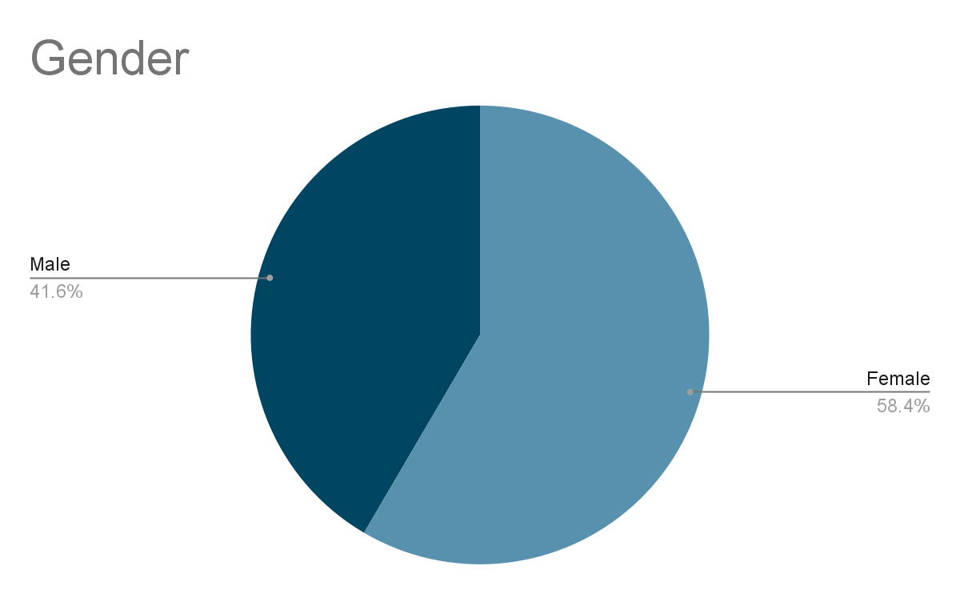

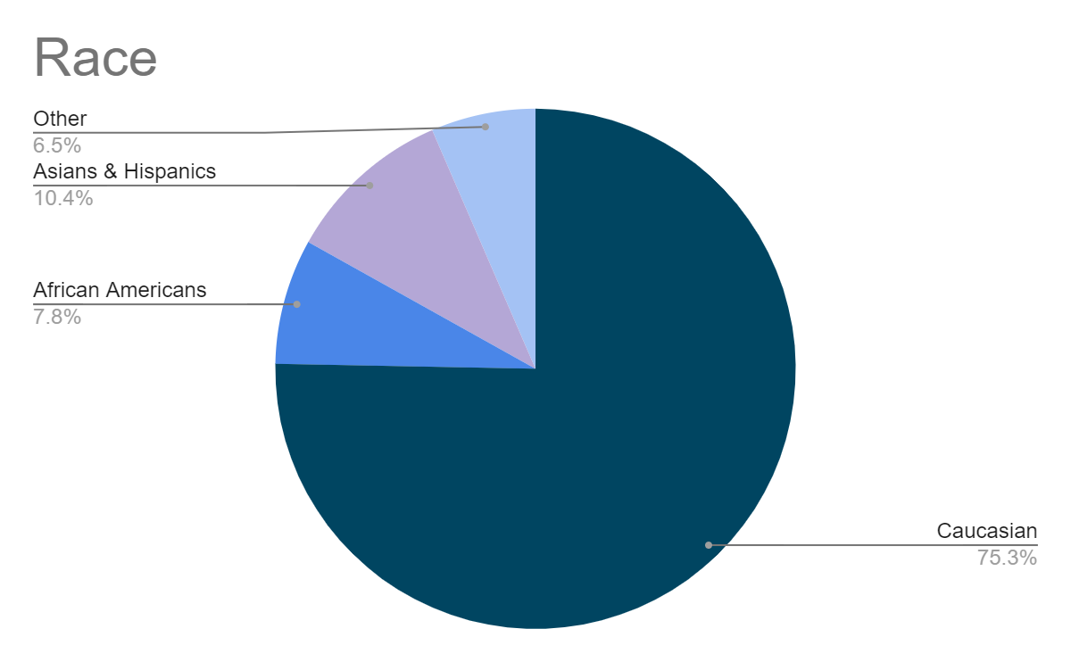

Sample
48.7% had some sort of college degree
**An Average of 11.8 cigs a day
Notes:
Sarah

Slide 6
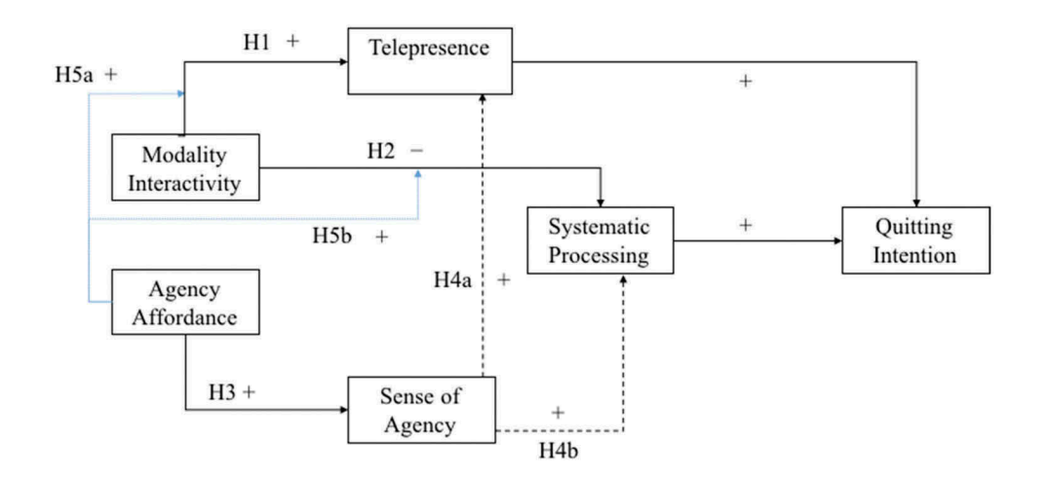
Method
To test the Hypotheses they created a study design that included the correlation between modality interactivity: low vs. high and agency affordances: absence vs. presence. There was also the use of social media presence involved in order to see what consumers were liking, commenting, and sharing on in order to gauge their feelings.
2 X 2
Factorial Experiment
Notes:
Sarah

Slide 7


Variables
Independent Variables
  Modality interactivity and agency affordances
Controlled Variables
  Smoking amount
  Facebook usage
  Sex
  The perceived intrusiveness of anti-smoking messages
Dependent Variable
  Intention to quit smoking
Notes:
Sarah

Slide 8

Procedure & Calculations
Participants’ demographic information and smoking status were measured and they were then asked to complete a browsing activity that required them to compare bodies of smokers and non-smokers on an anti-smoking site.
Participants were assigned to one of four website conditions and told to learn about the information on the website.
Participants given social media plugins were also told to use buttons to share how they felt about the website.
Log data of participants was recorded.
When participants were done browsing, they were asked to complete a survey.
  9 Point Likert Scale
Notes:
Meredyth

Slide 9

Hypotheses Results
H1 & H5a
  H1: Since there was barely a noticeable difference between the slider condition and click condition, it was concluded that there is not a significance between the feelings of modality interactivity on feelings of telepresence
  H5a: Participants ended up feeling higher levels of telepresence in the slider condition when there were social media plugins involved
H2 & H5b
  H2: Was not supported due to there being no effect on modality interactivity and systemic processing
  H5b: Modality interactivity reduced systematic processing compared to the control condition as standardized sense of agency score decreased, thus H5b was supported.
Notes:
sarah

Slide 10
Hypotheses Results Cont.
H3 & H4a / H4b
  H3: was a proven hypothesis because the social media plugins condition reported a greater sense of agency than those in the control condition, showing that the participants were more likely to feel that they could express their thoughts more freely while browsing the website
  H4a / H4b: Participants felt that they out to express their ideas freely by having control of the sites features, this positive perception enhanced their emotions of telepresence and inspired them to pay a greater interest to the website’s messages, making both H4a and H4b supported.
Notes:
meredyth

Slide 11
Hypotheses Results Cont.
H6 a&b
  H6a: In the presence of social media plugins participants reported greater feelings of telepresence, resulting in a greater change in quitting condition. YET without social media plugins, modality interactivity alone did not bring about any change in quitting intention. H6a was supported.
  H6b: Without social media plugins, sliders reduced systematic processing. SO less quitting intention. WITH social media plugins, there was no significant effect of modality interactivity on systematic processing. Thus H6B was supported
Notes:
Diego
Basically, having social media plugins on a website does not stop us from processing the information we take in
AND in the case of persuading people to quit smoking, social media plug ins helped people

Slide 12
Methodological Critique
Sampling:
The age of the participants was not specified. Perhaps the age of the participants would have affected survey results. We think that a “generational gap” might have an effect on people’s quitting intention.
Measurement:
In this study, researchers could have asked if participants’ families have a history of addiction.
Method:
“the amount of cognitive load associated with modality interactivity” (Oh, Kang, Sudarshan & Lee, 2020)
Notes:
Meredyth
According to the study, research conducted in the future should also try to measure “the amount of cognitive load associated with modality interactivity” (Oh, Kang, Sudarshan & Lee, 2020) so that other explanations of findings no longer have to be taken into consideration. The sliders used in this study may not have caused significant enough changes in cognitive load for it to make a difference. Given that the sliders cause users to pay attention to only a few sections on the site, skimming may have been more likely for the rest of the site’s content. (Oh, Kang, Sudarshan & Lee, 2020)

Slide 13
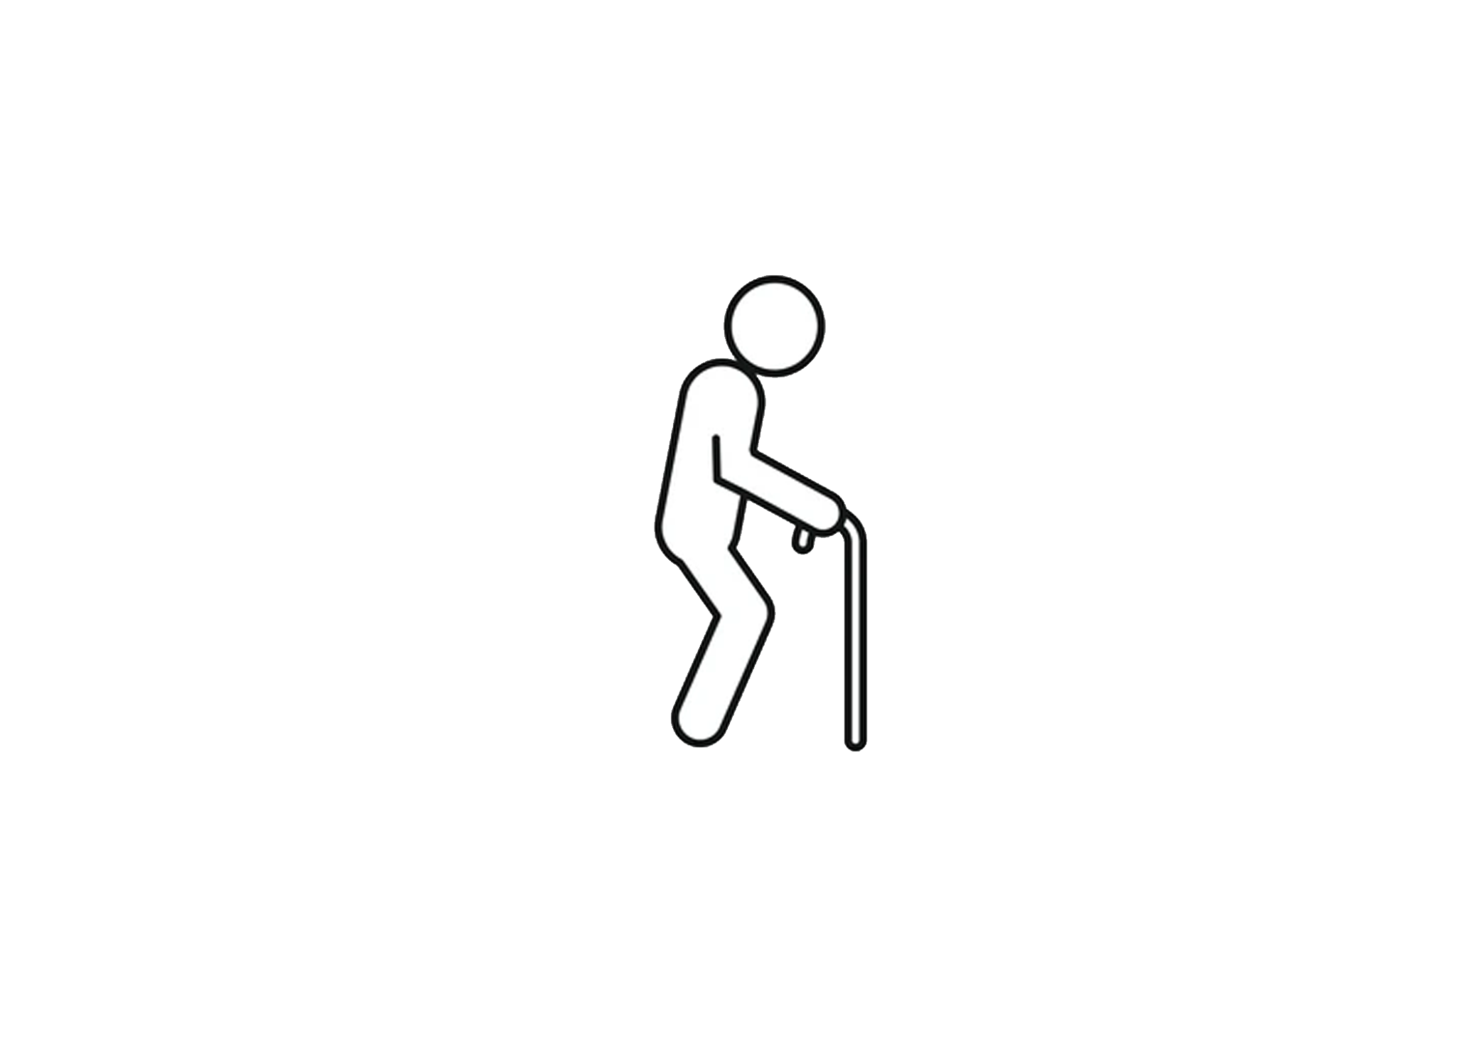

Further Discussion
If the research study would have mentioned not just smoking, but vaping and cigarettes, would results have been different?
Would a generation gap have an effect on quitting intention?
2.
Notes:
Meredyth

